Slide 1
Lesson objective
Title: Calculating Perimeter and Area
Aim
Be able to:
calculate perimeter of common shapes
Determine the area for calculate area of simple shapes
Plan:
Daily review
  Substitution
Perimeter
Area
Need whiteboards.

Slide 2
Substituting values
Students complete in exercise book.
If a = 4, e = 7 and g = 3, substitute the values and evaluate:
2a
ge
3e – 3g
Answers
2 x 4 = 8
3 x 7 = 21
(3 x 7) – (3 x 3)
= 21 – 9
= 12

Slide 3
The perimeter is:
The total length forming the boundary of a closed geometrical figure.
The ____ length forming the boundary of a closed geometrical figure.
The ____ length forming the ________ of a closed geometrical figure.
What is the line forming a boundary of a shape called?

Slide 4
Whiteboards
Perimeter is plus
Perimeter is plus
Perimeter is plus all the sides together.
What is the perimeter of the following shapes:
5m
12mm
3m
3m
6cm
6cm
20mm
20mm
5m
8cm
12mm

Slide 5
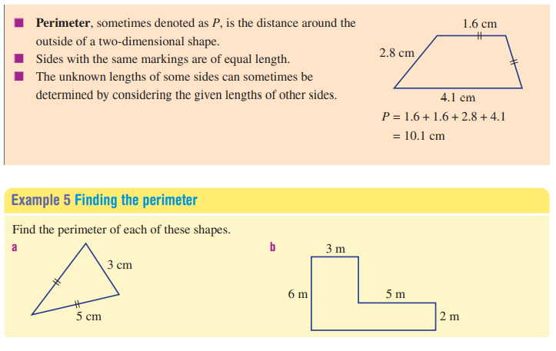
4m

Slide 6
Finding perimeter: I do
Example 1
Example 2
8cm
10m
5cm

Slide 7
Finding Perimeter: we do
Example 3
Example 4
5m
10cm
1m
6m
8cm
7cm

Slide 8
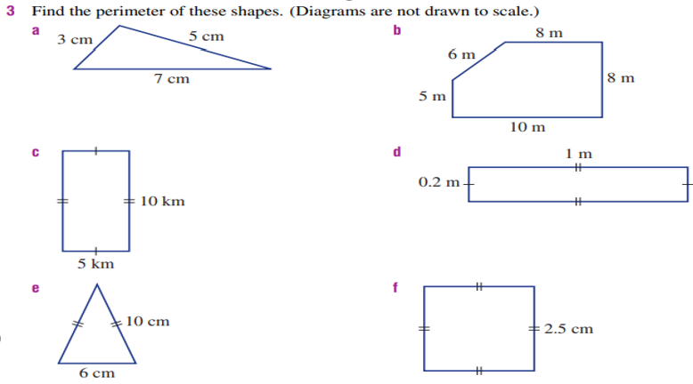
Finding perimeter: you do
In your exercise books.
Notes:
A = 15cm
B = 37m
C = 30km
D= 2.4m
E = 26cm
F= 10cm

Slide 9
Drawing perimeter
Work with the person next to you and try and draw a rectangle with a perimeter:
16cm
20cm
They do not have to be exactly measured out
Start by drawing a small rectangle and experimenting
with sides
Width
length
length
Width

Slide 10
Area of a shape
Area is the amount of space taken up by a 2D shape or surface.
Area is the ______ of space taken up by a 2D shape or surface.
Area is the ______ of _____ taken up by a 2D shape or surface.
What is Area?

Slide 11
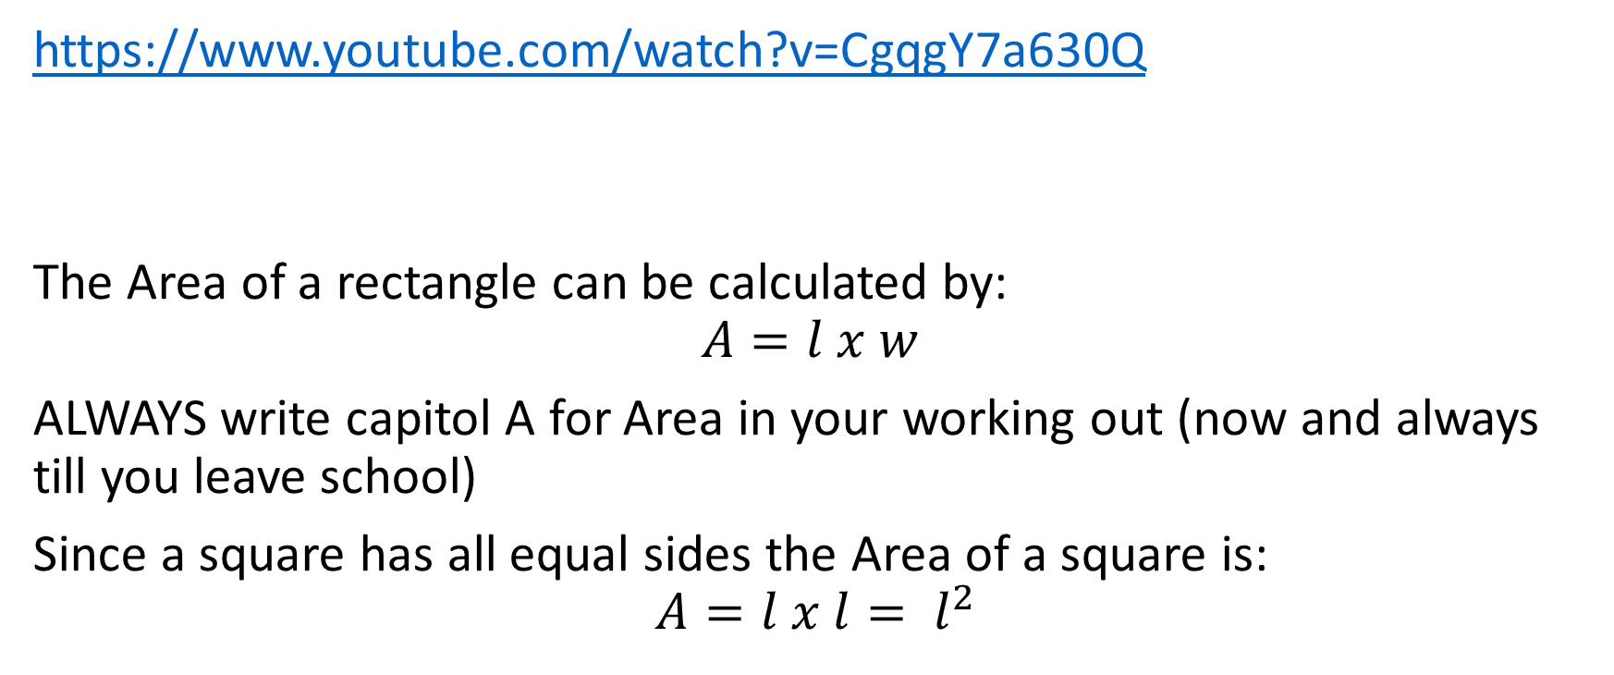
Area of a rectangle
https://www.youtube.com/watch?v=CgqgY7a630Q
The Area of a rectangle can be calculated by:
$$A=l x w$$
ALWAYS write capitol A for Area in your working out (now and always till you leave school)
Since a square has all equal sides the Area of a square is:
$$A=l x l= l^{2}$$

Slide 12
Calculate the area of these rectangles
Page 453
Question 4a ➔ 4f
Page 461
Question 6a ➔ 6i

Slide 13
Reflection – fist to 5
Aim
Be able to:
calculate perimeter of common shapes
Determine the area for calculate area of simple shapes
Rate yourself on our lesson objective.

